Slide 1

Report on
Middle East Language Learning in Higher Education
Kirk Belnap, Ray Clifford, Erika Gilson, and Maggie Nassif
Title VI 50th Anniversary Conference
Washington, D.C.
19 March 2009

Slide 2
“A pervasive lack of knowledge about foreign cultures and foreign languages threatens the security of the United States as well as its ability to compete in the global marketplace and produce an informed citizenry.”
2007 Report of the National Research Council Committee to Review Title VI and Fulbright-Hays International Education Programs
Notes:
Increase East-West understanding through:
More graduates with high-level linguistic and cultural fluency, resulting in better diplomats, scholars, journalists, analysts…
More citizens with at least basic familiarity with this region of major political, economic, and cultural interest

Slide 3
NMELRC Leadership
Kirk Belnap, Director, BYU
Maggie Nassif, Administrative Director, BYU
Mahmoud Al- Batal
UT - Austin
Associate Director Professional Development
Erika Gilson
Princeton
Associate Director
Language Assessment
Shmuel Bolozky
Massachusetts - Amherst
Associate Director
Pathways to Proficiency
Kristen Brustad, UT Austin
Muhammad Eissa, Chicago
Suzan Oezel, Indiana
Vardit Ringvald, Brandeis
Renana Schneller, Minnesota
Martha Schulte-Nafeh,
UT Austin
Vered Shemtov, Stanford
Dwight Stephens, Duke
Roger Allen, Penn
Mahdi Alosh, USMA
Micheline Chalhoub-Deville,
UNC Greensboro
Nihan Ketrez, Yale
Salah-DineHammoud,
USAFA
Roberta Micallef, Boston
Vardit Ringvald, Brandeis
Martha Schulte-Nafeh,
UT Austin
Kamran Talattof, Arizona
Ruth Adler Ben-Yehuda,
Brown
Benjamin Hary, Emory
Ahmad Karimi-Hakkak,
Maryland
Sylvia W. Onder,
Georgetown
Vardit Ringvald, Brandeis
Muhammad Eissa, Chicago
Kamran Talattof, Arizona

Slide 4
Mandate for Title VI Language Resource Centers
“Improve the Nation’s Capacity to Teach and Learn Foreign Languages Effectively”

Slide 5
LRC Priorities
(according to Title VI Legislation)
Research
Materials Development/Dissemination
Performance Testing
Teacher Training
Assess LCTL Needs, Develop Action Plans
K-12
Advanced Summer Intensive Programs

Slide 6
NMELRC Mission
reach more students
increase quality of learning opportunities for all students

Slide 7
“Assess LCTL Needs, Develop Action Plans”
surveys of students, teachers, administrators
site visits, telephone interviews
study of hiring/staffing practices, implications
collect outcomes data from language programs and funding agencies

Slide 8
Student Survey
  Demographics
  Motivation / Goals
  1500+ students surveyed

Slide 9
Teacher Survey
  Employment Demographics
  Priorities / Satisfaction
  191 teachers surveyed
Language Program Administrator Survey
  Program Details
  Priorities, Challenges, Prospects
  89 administrators surveyed

Slide 10
Arabic Enrollments (MLA)
Notes:
DLI is removed from 2-year schools here.

Slide 11
Hebrew Enrollments (MLA)

Slide 12
Persian Enrollments (MLA)

Slide 13
Turkish Enrollments (MLA)

Slide 14
But how are we doing in terms of outcomes?
Notes:
CLS, CASA, Flagship, STARTALK

Slide 15
Third-Year Course Enrollments
NMELRC Survey
 | 2006 | 2008 | % change
Arabic | 432 | 580 | 34%
Hebrew | 109 | 115 | 6%
Persian | 31 | 54 | 74%
Turkish | 31 | 25 | -19%

Slide 16
Critical Languages Scholarship Applications
 |  | 2008 applied | 2008 awarded | 2009 applied | 2009 awarded | % +/- applied
Arabic | Beginning | 1345 | 73 | 1495 | 73 | 11%
 | Intermed. | 759 | 65 | 872 | 65 | 15%
 | Advanced | 234 | 65 | 388 | 55 | 66%
Persian | Intermed. | 60 | 8 | 77 | 8 | 28%
 | Advanced | 17 | 7 | 29 | 7 | 71%
Turkish | Beginning | 293 | 17 | 279 | 25 | -5%
 | Intermed. | 73 | 19 | 102 | 17 | 40%
 | Advanced | 28 | 14 | 32 | 10 | 14%

Slide 17
Who are these students and what are their goals?
Notes:
CLS, CASA, Flagship, STARTALK

Slide 18
Profile of Students Surveyed
Mostly undergrads (74%), grads (19%)
Their priorities:
  travel to the region (79%)
  achieve “professional-level fluency” (75%)
  better understand the culture (70%)
  modern press, other media (65%)
  art, literature (53%)
  employment (51%)

Slide 19
Students’ Professional Plans
Notes:
These are not mutually exclusive categories!

Slide 20
Pres. Obama’s Educational Priorities
  Universal Preschool
  Standards and Testing
  Teacher Quality
  Innovation
  Higher Education
Notes:
Recently, President Obama outlined his priorities for progress on the education front. These have proven to be a particularly good fit for our findings. While universal preschool language programs are certainly a worthy goal to work toward, we’ve adapted the category slightly as “Early Start.”

Slide 21
Educational Priority
Standards
and Testing

Slide 22
The Benefits of
Appropriate Assessment:
And the Dangers of Using
Inappropriate Tests
Ray T. Clifford

Slide 23
A Paradigm Shift in University Accreditation Standards
There is an unprecedented move to replace process reviews with outcome reviews.
Accreditation and Student Learning Outcomes: A proposed Point of Departure.
  Knowledge outcomes.
  Skills outcomes.
  Affective outcomes.
  Abilities (the integration of KSA outcomes).
Peter T. Ewell , Council for Higher Education Accreditation, September 2001

Slide 24
What will be the effect of these accreditation requirements?
More testing will take place.
  Some beneficial.
  Some detrimental.
These tests will influence learning, because:
  Students have a “Will that be on the test?” attitude.
  There will be a temptation to “teach the test” instead of teaching the skills necessary to pass the test.
  Every testing decision creates a “washback” effect on teaching and learning.

Slide 25
“Washback” Effects
Testing has a negative impact when:
  Educational goals are reduced to those that are most easily measured.
  Testing procedures do not reflect course goals, for instance…
    Giving multiple choice tests in speaking classes.
    Using grammar tests as a measure of general proficiency.
  The test results aren’t useful.

Slide 26
The National Debate on
School Testing
One formula for evaluating school performance
School score = (((((X23*100)*Y23) + ((X24*100)*Y24) + ((X25*100)*Y25) + ((X26*100)*Y26) + ((X27*100)*Y27) + ((X28*100)*Y28) + ((X29*100)*Y29) + ((X30*100)*Y30) / ((X23 + X24 + X25 + X26 + X27 + X28 +X29 + X30)*100)) + ((((Z23*100)*Y23) + ((Z24*100)*Y24) + ((Z25*100)*Y25) + ((Z26*100)*Y26) + ((Z27*100)*Y27) + ((Z28*100)*Y28) + ((Z29*100)*Y29) + ((Z30*100)*Y30)) /((Z23 + Z24 + Z25 + Z26 + Z27 + Z28 + Z29 + Z30)) / ((Z23 + Z 24 + Z25 + Z26 + Z27 + Z28 + Z29 + Z30)*100))) / 2
The Wall Street Journal, May 21, 2001, page A24

Slide 27
The National Debate on
School Testing
What would be the washback effect of this evaluation formula?
  Perhaps confusion?
  Perhaps frustration?
  Perhaps “teaching (items on the) the test” in a desperate attempt to improve results?

Slide 28
Washback Effects of Tests
Testing has a positive impact when:
  Tests reinforce course objectives.
  The test results are useful for students, teachers, parents, and/or administrators.
  Tests act as change agents for improving teaching and learning.

Slide 29
The Phenomenon of
Shrinking Educational Expectations
Students don’t want to waste their time studying what is not going to “needed.”
For students (and often teachers, parents, and administrators); the tests used and not a course’s stated learning objectives define what is “needed.” Therefore,
  Limited-scope tests reduce the breadth of learning.
  Simple tests reduce the level of learning.

Slide 30
Tests Can Reduce the
Breadth of Learning Outcomes
High academic goals are set and learner outcomes are defined.
1.
Teachers present as much of the textbook as time allows.
3.
Students are only tested on a sample of items drawn from the textbook.
Developers include examples of the most important goals in a textbook.
4.
2.
Instructional Goals and Learning Outcomes
Textbook
Teaching
Test

Slide 31
Tests Can Reduce the
Breadth of Learning Outcomes
High academic goals are set and learner outcomes are defined.
1.
Teachers present as much of the textbook as time allows.
3.
Students are only tested on a sample of items drawn from the textbook.
Developers include examples of the most important goals in a textbook.
4.
2.
Instructional Goals and Learning Outcomes
Textbook
Teaching
Test
Note # 1:
The tests used can limit the breadth of the students’ learning.

Slide 32
Tests Can Reduce the
Level of Learning Outcomes
Instructional outcomes can be divided into three types of learning.
In general, there are three kinds of tests.
When desired learning outcomes are not aligned with the kind of test used, learning suffers.

Slide 33
The type of learning expected :
3 Types of Learning Outcomes
Limited Transfer
Near Transfer
Far Transfer
Notes:
33

Slide 34
The 1st Type of Learning Outcome
With limited transfer learning, students…
  Memorize and practice specific responses.
  Focus is on the content of a specific course, textbook, or curriculum.
  Learn only what is taught.
Notes:
34

Slide 35
The 2nd Type of Learning Outcome
With near transfer learning, students…
  Go beyond rote responses to rehearsed and semi-rehearsed responses.
  Focus on a predetermined set of tasks or settings.
  Apply what they learn within a range of familiar, predictable settings.
Notes:
35

Slide 36
The 3rd Type of Learning Outcome
With learning for far transfer, students…
  Develop the ability to transfer what is learned from one context to another.
  Acquire the knowledge and skills needed to respond spontaneously to new, unknown, or unpredictable situations.
  Learn how to continue learning and to become independent learners.
Notes:
36

Slide 37
The testing method used:
3 Types of Tests
Achievement
Performance
Proficiency
Notes:
37

Slide 38
The 1st Type of Test
Achievement tests measure:
  Practiced, memorized responses.
  What was taught.
  The content of a specific textbook or curriculum.
Notes:
38

Slide 39
The 2nd Type of Test
Performance tests measure:
  Rehearsed and semi-rehearsed responses.
  Ability to respond in constrained, familiar, and predictable settings.
  Whether learning transfers to similar situations.
Notes:
39

Slide 40
The 3rd Type of Test
Proficiency tests measure:
  Whether skills are transferable to new tasks.
  Spontaneous, unrehearsed abilities.
  General ability to accomplish tasks across a wide variety of real-world settings.
Notes:
40

Slide 41
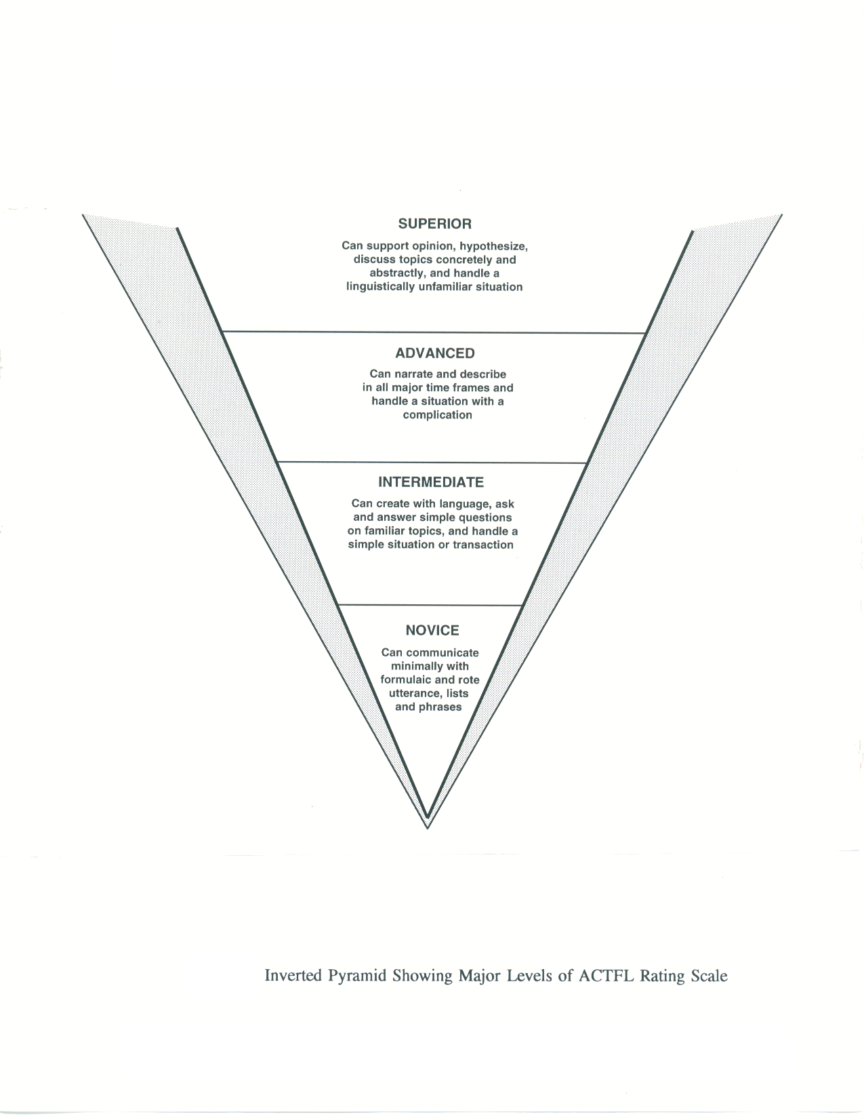
The Major ACTFL Levels
Notes:
Walk through major levels. Draw attention to key function words of each level.

Slide 42
General Proficiency Requires a Transfer of Learning
A By-Level Proficiency Summary with Text Types
(Green = Far Transfer, Blue = Near Transfer, Red = Limited Transfer)
ILR LEVEL
FUNCTION/TASKS
CONTEXT/TOPICS
ACCURACY
All expected of an educated NS [Books]
All subjects
Accepted as a well-educated NS
5
4
Tailor language, counsel, motivate, persuade, negotiate [Chapters]
Wide range of professional needs
Extensive, precise, and appropriate
Support opinions, hypothesize, explain, deal with unfamiliar topics [Multiple pages]
Practical, abstract, special interests
Errors never interfere with communication & rarely disturb
3
2
Narrate, describe, give directions [Multiple paragraphs]
Concrete, real-world, factual
Intelligible even if not used to dealing with non-NS
Q & A, create with the language [Multiple sentences]
Intelligible with effort or practice
1
Everyday survival
0
Memorized [Words and Phrases]
Random
Unintelligible
Notes:
42

Slide 43
Aligning Learning and Testing
Limited Transfer <=> Achievement
  Memorized responses using the content of a specific textbook or curriculum.
Near Transfer <=> Performance
  Rehearsed ability to communicate in specific, familiar settings.
Far Transfer <=> Proficiency
  Unrehearsed general ability to accomplish real-world communication tasks across a wide range of topics and settings.
Notes:
43

Slide 44
When teaching and testing are not aligned, learning suffers.
Limited Transfer Teaching
+ Proficiency Testing
= Learning Failure
  Learners won’t be prepared for the tests.
  Motivation will be reduced.
Far Transfer Teaching
+ Achievement Testing
= Limited Transfer Learning
  Students will adjust their learning to the tests.
  Motivation will be reduced.
Notes:
44

Slide 45
When teaching and testing are not aligned, learning suffers.
Limited Transfer Teaching
+ Proficiency Testing
= Learning Failure
Far Transfer Teaching
+ Achievement Testing
= Limited Transfer Learning
Note # 2: The tests used can limit the level of the students’ learning.
Notes:
45

Slide 46
Conclusion:
Use Appropriate Testing Procedures
Don’t select tests based on their price, availability, or ease of scoring.
Do insure that the tests used match the breadth of your desired learner outcomes.
Do insure the type of test used matches the level of learning desired.
  Achievement tests for limited transfer objectives.
  Performance tests for near transfer objectives.
  Proficiency tests for far transfer objectives.

Slide 47
If these suggestions are followed, a different educational model will emerge – a model that will:
Not be based on successively derived, reduced subsets of the real objectives.
Maintain students’ and teachers’ focus on the program’s true learning objectives.
Change the role of the teacher from “presenter” to “facilitator.”

Slide 48
We Can Replace Reduced-Scope,
Test-Based Instruction…
High academic goals are set and learner outcomes are defined.
1.
Teachers present as much of the textbook as time allows.
3.
Students are only tested on a sample of items drawn from the textbook.
Developers include examples of the most important goals in a textbook.
4.
2.
Instructional Goals and Learning Outcomes
Textbook
Teaching
Test

Slide 49
…with Outcomes-Based Instruction
2a.
Course developers sample from the real-world domain areas to create a textbook.
Set instructional goals and define expected learner outcomes.
Textbook
1.
Real-world Instructional Domains: cognitive understanding, psychomotor skills, and affective insights.
Teachers adapt text materials to learners’ abilities, diagnose learning difficulties, adjust activities and add supplemental materials to help students apply new knowledge and skills in constrained achievement and performance areas, and then in real-world proficiency settings.
3.
Teacher
Test developers use an independent sample of the real-world domain areas to create proficiency tests that are not based on the textbook.
2b.
Students
4.
Test
Students practice, expand, and then demonstrate their unrehearsed extemporaneous proficiency across a broad range of real-world settings that are not in the textbook.

Slide 50
But the Switch to Outcomes-Based Instruction will Require:
Improved assessment literacy for everyone: Teachers, Administrators, Students, and Parents.
Ongoing communication among stake holders.
A tolerance for formative assessment that allows programs to “fail forward.”
Clearly stated Expected Learner Outcomes (ELOs).
Assessment practices that match our ELOs.

Slide 51
Educational Priority
Teacher Quality
Notes:
Since the 1980s there has been increasing emphasis on teaching/learning for “proficiency.” Title VI programs played a leading role in moving the Middle East language teaching fields to a more communicative approach.

Slide 52
Who are the Teachers in our Sample?
  10% (17) Assistant Professors
  10% (16) Associate Professors
  10% (17) Full Professors
  34% (56) Lecturers
  14% (24) Senior Lecturers and professors of the practice
  22% (36) Student Instructors
Notes:
The majority are in the non-tenure track, often graduate students - even undergraduate students - are the instructors.
52

Slide 53
  68% are full-time
  32% are part-time
  18% are tenured
  82% are non-tenure track [includes part-time]
    48% have PhD
    28% have MA
    16% have BA
    8% “other,” including 2-year degree
Notes:
The majority are part-time, most have no teaching certificate which is not surprising since the field of teaching these languages is just beginning to develop.
53

Slide 54
Language teaching is great…
  82% of teachers are satisfied or very satisfied with language teaching as a profession.
  78% plan to teach until retirement.

Slide 55
Language teaching is great, but …
Only 31% are satisfied with their salary.
51% also work at other institutions or summer schools to supplement their income.
Notes:
Unfortunately, the general academic climate and staffing practices in higher education are such that they do not encourage and may actually discourage bright students from considering a career in language teaching. Those who teach language are typically appointed as lecturers, who typically have little or no job security. To add insult to injury, they are decidedly second-class citizens. Academic research and publishing is not encouraged, nor recognized.
Even tenure-track faculty with a research focus on language pedagogy can find themselves in a tenuous position, given that their field is not a traditionally recognized academic discipline.
Important: The ‘no opinion’ option to the two questions regarding encouraging students to consider a teaching career is higher than at other questions,perhaps indicating substantial amount of hesitancy.
55

Slide 56
Only 47% would recommend language teaching as a profession to their students.
  57% of Assistant Professors
  64% of Associate Professors
  50% of Full Professors
  39% of Lecturers
  44% of Senior Lecturers
Notes:
Last week the Harvard coordinator for Middle Eastern language offerings told us that Harvard’s name is no longer enough to draw good teachers.

Slide 57
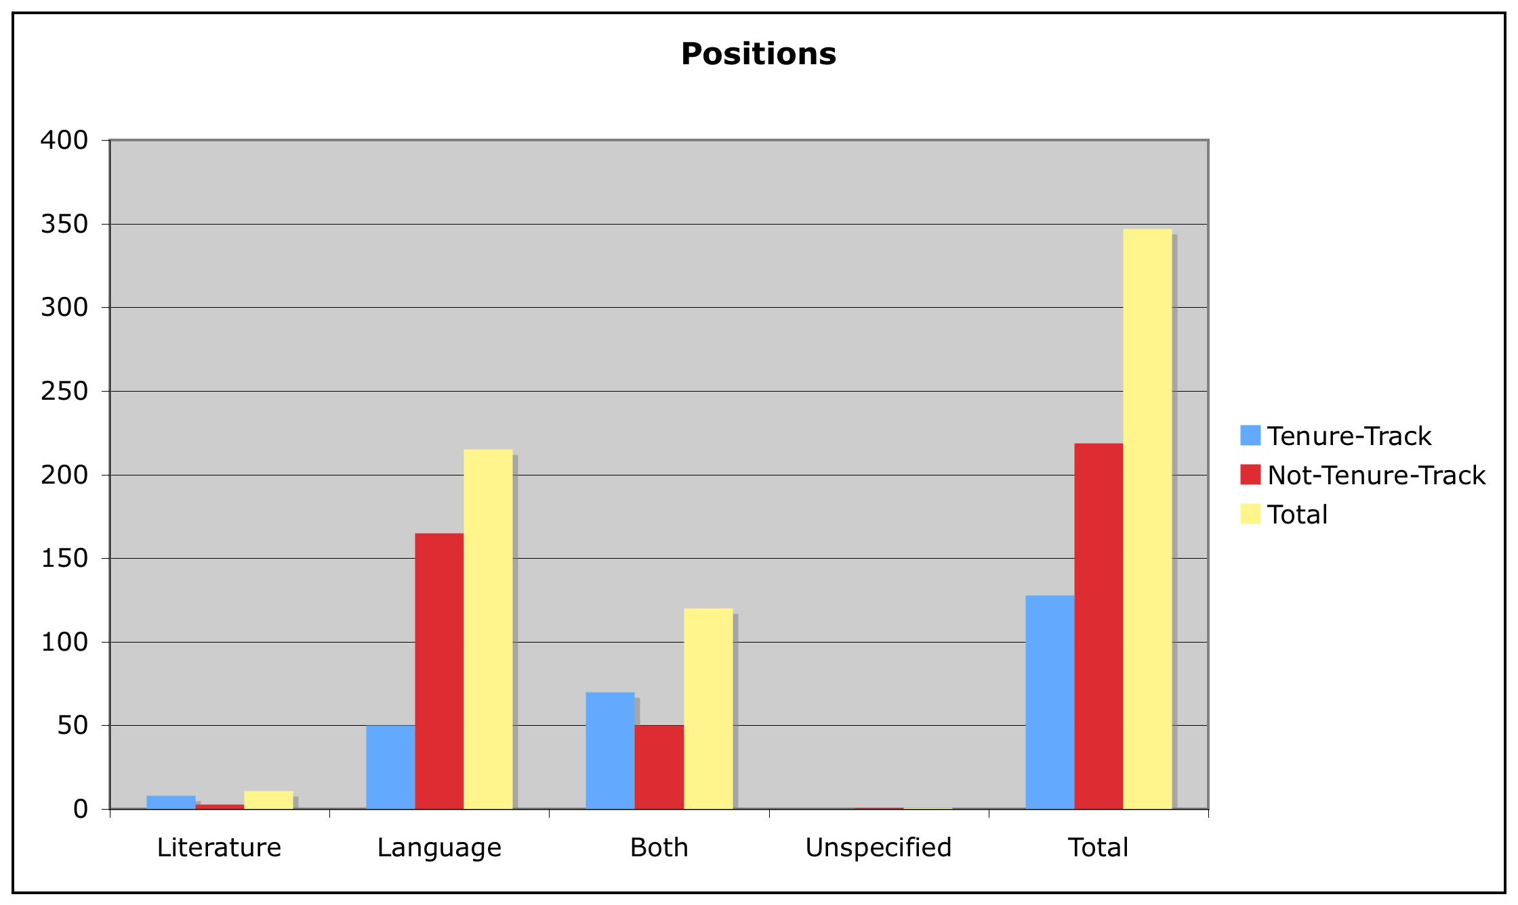
Language Teaching Positions
Advertized from 2000-2008
Notes:
Of all positions announced for language and literature 2000-2008, language-only positions are 3 times more likely to be non-tenure.
57

Slide 58
Quality Teachers Make a Significant Difference
 | All Positive Predictors¹ |  | All Neg. Predictors²
 | Mean | n | Mean | n
% lg. used in class | 59.9 | 90 | 39.8 | 106
hrs/week homework | 8.8 | 99 | 4.6 | 111
class hrs/week | 5.5 | 110 | 4 | 126
¹ Includes courses taught at private research universities that house NRCs.
² Includes courses taught at public non-research universities without NRCs and not known for commitment to teaching Arabic.
Data Source: CAORC
Notes:
Time on task is the key to learning. A multiple regression analysis of data from thousands of students who applied to the Critical Languages Scholarship program revealed that there is a statistically significant difference between language programs. This table gives the mean responses from institutions that exhibit all positive and all negative predictors (the polar ends of a continuum). Note that the target language is used in the classroom by the teacher and students far more in NRC language programs. Likewise, the amount of homework done each week in the NRC programs dwarfs that done in the others. Classes at NRC institutions also meet more hours per week.
These results should in no way be taken to mean that all is well in NRC classrooms—or not well elsewhere!

Slide 59
Case Study:
Turkish at Middle East NRCs
Notes:
Almost a step child - lagging behind the other ME languages:
59

Slide 60
Turkish at Middle East NRCs
0 Full Professors
2 Assoc. Professors
1 Visiting Assistant Professor
5 Senior Lecturers
7 Lecturers/Lectors/Preceptors
2 Graduate Student Instructors (part-time)
Compared to 1972: six major NRCs that had professorial rank faculty have only lectureships now.
Notes:
I want to highlight the situation at NRCs today versus some 20 years ago when I studied for my doctorate. There were six full professors at one major NRC who contributed to my education in the field of Turkic linguistic studies.

Slide 61
Case Study:
Modern Hebrew
The Next Generation
Notes:
While Arabic has rebounded to some degree from the lack of students pursuing PhDs in applied linguistics, other fields are not so fortunate.

Slide 62
There are some institutions training teachers of Hebrew, like the Jewish Theological Seminary,
and some PhD programs in Hebrew literature, notably U.C.-Berkeley.
There are also some PhD students in linguistics departments whose work involves some research on Hebrew.

Slide 63
But to the best of my knowledge, there are no PhD candidates anywhere in the U.S. in Modern Hebrew language, nor PhD candidates in applied linguistics or specialists in second/foreign language acquisition whose concentration is [Modern] Hebrew.
Shmuel Bolozky, Prof. of Hebrew at Univ. of Mass.-Amherst and NMELRC Assoc. Director for Infrastructure Building

Slide 64
Case Study:
Persian
The Next Generation
Notes:
Strategic investments can make a difference.

Slide 65
Persian Field Building
Between 2001 and 2006, we know of only one Persian language professional working in higher education that could be considered an applied linguist. The Persian Flagship Program at the Univ. of Maryland now has three Persian PhD applied linguists on staff.
Notes:
Retention of personnel, however, is a challenge for the Persian Flagship program, given that only one-year lectureship contracts are currently offered.

Slide 66
Voices of those without a Voice
Notes:
We have previously shared personal accounts of those who have left the field or are considering leaving the field due to the poor conditions that language lecturers face. The following account underscores yet another danger to our system of higher education which is increasingly reliant on contingent faculty:
As an itinerant academic, chronically contingent, who has taught at nearly a dozen different colleges and universities over the course of a decade-and-a-half, I am as familiar as any non-tenure-track academic with the routine disadvantages of such employment: low pay, uncertain prospects, excessive workloads, etc. All of this and more has been discussed at great length in articles appearing in Academe, The Chronicle of Higher Education, and elsewhere. Lately more attention is being given--and rightly so--to the broader ramifications of these issues, as pertaining to the very future of higher education in the United States. I refer specifically to the gradual degradation of academic standards, the challenge of meaningful assessment--which some colleges and universities are attempting to meet by imposing anti-grade-inflation policies, to mixed effect and frequently in the face of vociferous student protest--and the delicate position in which contingent faculty, vulnerable to begin with, often find themselves as their institutions grapple with these questions, or, in some cases, decline to grapple with them. Where anti-grade-inflation policies are in effect, faculty may be expected to limit the number of A's they award in their classes to a certain percentage. Because students tend to hold their instructors immediately responsible for grades they perceive as lower than they deserve, the result may be poor teacher evaluations, which can have especially dire implications for an instructor whose employment status is unstable to begin with; thus contingent faculty find themselves between the proverbial rock and hard place: the administration's scrutiny on the one hand, and their students' criticism on the other.
Then there are those institutions where grade inflation is not being in any way remediated: where students have a range of opportunities to improve their grades superficially--for example, by undertaking projects or activities that do not in fact contribute substantially to the skills or knowledge base they are supposed to be developing in a given class, but that allow them to achieve an artificially enhanced grade in no way reflecting their actual achievement or proficiency level in that class. Professors and their departments may participate in this sort of systematic grade-inflation, and the administration may turn a blind eye to it, because they find that the prospect of an easy A tends to attract students to their programs--and these days education often seems to be all about numbers: getting and sustaining high enrollments at almost any cost. An academic with job security has some latitude to resist this trend if he or she perceives it as unethical and/or wishes to discourage non-serious students from taking his or her classes. Contingent faculty are not so free. An adjunct or other non-tenure-track instructor may feel compelled by the terms of his or her employment to partake in a system that not only does not accord with his or her teaching philosophy, but also imposes on him or her classrooms full of students whose commitment to the subject being taught is low or non-existent--who are, in effect, merely "along for the ride." The demoralizing effect of this is hard to measure; it can cause an instructor to call into question the very meaningfulness of his or her profession. Troubling as the immediate personal and professional implications of this situation are for contingent faculty, it seems to me that there are even larger issues at stake, if colleges and universities in this country are to continue to produce graduates with genuine qualifications and not merely a set of meaningless paper credentials.
I have no immediate solution to suggest. I am very glad that the issues most particularly affecting contingent faculty are getting the attention they have attracted in recent years; I also hope that the measures that should be taken to redress those concerns might ultimately produce a more viable academic infrastructure across the board.

Slide 67
Educational Priority
Early Start

Slide 68
K-12
Catching up with the rest of the world
Why foreign languages?
Notes:
Catching up with the rest of the world
The issue of foreign language training as part of the preparation process of the American students for the global workforce in the 21st Century is not only vital because of its obvious connection to National Security, but also because of its being one of the three basic skills that insure competitiveness: Math, Science and Foreign Languages. Our long term plan in the academy should be to build well articulated, sequential programs that start in elementary schools with full immersion of students in foreign languages through instruction of core subjects in the target language. These students would go on to achieve Superior-level proficiency. Our hope is that such programs in the US would then breed well qualified teachers who would employ best practices, demonstrate success through using valid assessment tools, and run sound stateside and overseas programs to produce more students who will flow through this national pipeline. Unfortunately, while we have currently very few of these early start programs in the U.S., this long term dream would put us on par with schools that have been doing this in India, the Middle East and other parts of the not-so-industrialized world where students effortlessly acquire three and more languages as part of their basic education. Building on their success will help us catch up with countries like the Sudan, Mali, Vietnam and Pakistan. This type of basic education is available to students there who then go on to become bilingual doctors, trilingual economists or military experts.
Why foreign languages?
In an article published in January 2009, in The Competitiveness Review Journal, the authors stated that "The Mckinsey Global Institute projects that in theory 11% of total service employment could be done remotely in the future. This will result in shaving off the lower tiers of the workforce leaving only higher jobs, which require more skilled workers who are able to compete in a global world with no borders. At the higher education level, India and China currently produce 500,000 engineers a year, while in the US the number is 60,000. India alone graduates 70,000 accountants per year. In an OECD (Organization for Economic Co-operation and development) study conducted in the 90’s, American schools ranked second to last among industrialized nations when it came to teaching science. In addition, American students do not speak enough foreign languages, keeping in mind that as economic powers shift, they will be competing to offer services to emerging markets in China, India, the Middle East, Korea and Brazil. ….The global work force needs to be: Bilingual, able to navigate a multi-cultural environment, good at math and science. " Competitiveness Review: Vol 19.1, (2009)
Outreach : The marketing Campaign:
We will only be successful in changing this culture of the status quo to one that is ready to make our children competitive if we secure buy-in from parents, teachers and community leaders. Our job is to make the point that introducing foreign language instruction in elementary school fits in the overall blue print of preparing their child for the workforce. Unfortunately, in academia the focus has always been on perfecting the program and less on signing up the “buyers,” to the extent that it is like researching and developing a product and forgetting to sell it.
As in any crucial assignment, to insure success, we need to secure a capable team of experts that are highly skilled and trained in shaping cultures. This campaign needs to be planned and executed by marketing experts that “position” foreign languages as a coveted skill that elevates the status of those who perfect it. We need to be thinking: How do we afford the respect and power we have for football coaches to foreign language teachers? How do we elevate bilingual students to the star status baseball players enjoy? How do we create foreign language scholarships that compete with college football packages? But most importantly, how do we create a caliber of students who can perfect the foreign language science, the way the American sports industry has taken the American athlete to a whole new height of physical capabilities that make her/him a winner by a huge stretch. We have been able to produce athletes that compete in a league of their own, where other nations follow by a large margin. When we reach this level in foreign languages, we will have proven that the return on investment in international education is a cost effective investment. The benefit achieved will be visibly evident in the contributions of American world leaders in science, and business. Whether they channel the world economy from the US or overseas, they will be able to comfortably navigate linguistic and cultural exchanges at home and while traveling. This brings us to the question: How do we prepare them for this travel experience? How do we ensure that the immersion study abroad experience is more than a nice trip but a cornerstone of their global job preparedness plan?

Slide 69
Outreach as a Sales Function
•The product
The team
The price
The pipeline: supply chain
How the K-12 language program fits into your child’s vocational training portfolio

Slide 70
Study Abroad
Report on meetings in:
Amman
Jerusalem
Cairo
Notes:
Study abroad:
With the surge in enrollment of Middle Eastern Languages since 9-11, there is a mad rush for students to seek an immersion experience in the Middle East and for U.S. universities to seek partnerships with in-country institutions to provide this experience. In the last few years the overseas summer and intensive program field has experienced a sudden and multifold increase in enrollment for existing programs and the establishment of tens of new programs. This phenomenon poses both an opportunity and threat to the discipline of teaching of Middle Eastern Foreign Language.
Report on Meetings in Amman, Jerusalem and Cairo:
NMELRC held three study abroad summits in the Middle East in the summer of 2008. The first two meetings were held in Amman and Jerusalem in May, the third in Cairo in July. The meetings studied the challenges and opportunities that the recent interest in the region has presented Arabic and Hebrew Study Abroad programs in the Middle East.
With more than 20,000 American students currently learning Arabic in higher education and more public schools offering Arabic at the K-12 level, Arabic study abroad programs are overwhelmed. The meetings that brought stake-holders (administrators and instructors who represent in-country know-how and directors of Middle East programs in American universities) together studied ways for collaboration. The goal was to share visions, strategies and methods for the future development of the field.
The four main issues that were identified for immediate attention were:
Orientation: The need for students’ expectations to be clearly defined prior to arrival and carefully managed while in country. Students need to have a realistic vision of their potential in order to maximize the benefit of being in country.
Assessment: The dire need for standardized tests-like the TOEFL that would translate into meaningful articulation between stateside and overseas programs.
Teachers: Qualified, well-trained and talented teachers who are able to adapt to the new landscape and cater to the changing needs of students are key to reversing the one-size-fits-all solution that is currently—in most cases—the only option on the table.
Student demographics: The dramatic change in student demographics has left the field in need of adjusting its resources, including training teachers, developing curricula and designing an all-together new strategy to cope with the present situation.

Slide 71
Main Points of Concern
Orientation
Assessment
Teachers
Student demographics
How a study abroad experience becomes a professional internship
Notes:
How a study abroad experience becomes a professional internship
We come back to the question of how do we make the study abroad experience a positive step in the overall vocational training to prepare the American student for the global work force?
When a school has a well-articulated mission statement that is published and shared by all stakeholders, this serves as the backbone of the school. Similarly when a student has a well defined career goal that is supported and served by parents, teachers and advisors the job becomes manageable and doable. Match the right student with the suitable school.
On the student side: A pre-departure orientation that outlines what a student can expect from his host country, institute and himself, can help get the student off to a good start. Unrealistic expectations, whether too high or too low, are a sure recipe for disappointment. While in country, on-site mentoring is a very cost effective investment. A study abroad is essentially a journey, an internal one as well as a physical one. Ensuring that there is someone who can guide the students through their emotional reactions to a very highly stimulating time in their lives, helps them process issues in a more healthy way through regular debriefing on experiences as well as linguistic guidance, this helps students overcome hurdles as opposed to getting stuck, withdrawing, and resorting to avoidance behavior.
On the school side: We also need to understand how is this provider in the Middle East differentiating his/her program from other schools. Currently, most schools are differentiated through scale. There are big programs that are housed on university campuses, small private institutions and in between programs that are affiliated with American universities and are sometimes run from the US. With few exceptions—scope hardly comes in the mix here—programs seem to mostly provide the same services on a different scale. This is not a commentary on their quality rather the way these summer and intensive programs have packaged their services.

Slide 72
Differentiating Offerings
Program Length and structure
Program Mission and Niche
How do we find our niche and develop our product?
Notes:
How do we find our niche and develop product?
Program design and length should allow students to learn from being in country.
We need to partner with programs overseas to develop their own niche. Longer programs, but more importantly programs with in-country projects and internships, provide students the tools to identify partners among the native population and give them a purpose to dive into the professional and social life around them. Currently, most programs offer intermediate- and advanced-level instruction, some using the same textbooks that students use in their Arabic classrooms here in the U.S. Less is offered for more advanced students, specialists, professionals and experts who need languages for specific purposes. Through helping in country providers develop scope and ensuring that we send these students to schools that can cater to specific needs, enticing programs to develop small tailored executive programs, we can dramatically improve the immersion experience and yield better results. This will only be accomplished through innovative and creative approaches, certainly not by funding, creating, and doing more of the same.

Slide 73
Educational Priority
Innovation

Slide 74
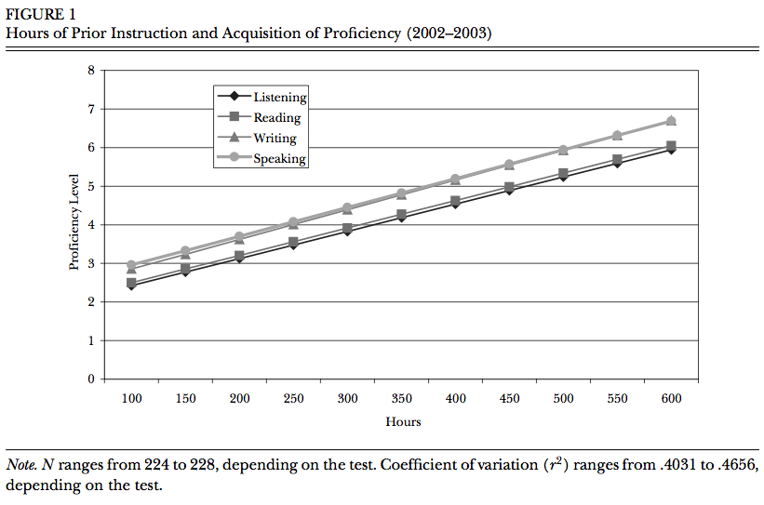
Making the Most of Motivation
Source: Rifkin, 2005

Slide 75
“If you build it they will come.”
1st-year
programs
from
coast
to
coast
quality
summer
intensive
programs
intensive semester abroad
flagship programs
Notes:
Approx.10% of American colleges and universities offer Arabic.

Slide 76

National Security Language Initiative
STARTALK Summer Language Camps

Slide 77
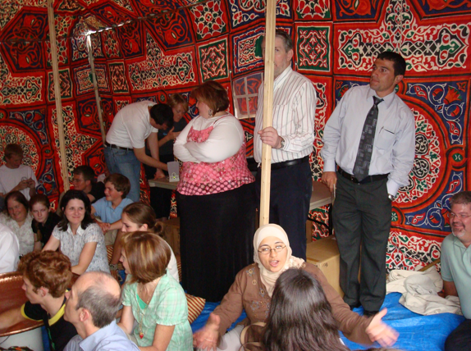

Slide 78
Arabic without Walls
(Hybrid Distance-Learning First-Year Arabic Course Funded by FIPSE Grant to Univ. of California Consortium on Language Learning & Teaching and NMELRC)
- asynchronous
- pragmatic use of technology
- maximize human interaction
- scaleable, modular
http://www.uccllt.info/aww/

Slide 79
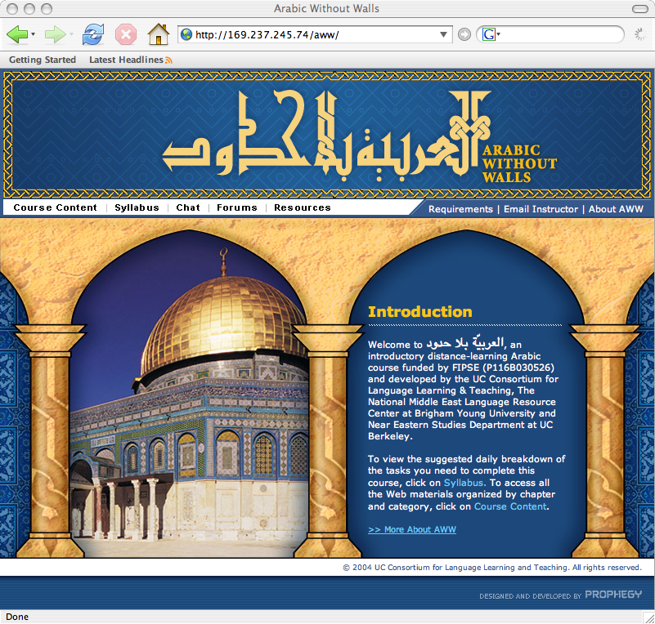
Cohorts of AWW learners constitute integrated learning communities, not loaners. After all, language is a social phenomenon.

Slide 80
And after Arabic Without Walls?
Notes:
Arabic Without Walls is designed to provide a quality first-year learning experience to those who have no access to such opportunities. AWW students are encouraged to continue their studies at a recommended summer intensive Arabic program and follow this with at least a semester abroad at a recommended intensive program in the Arab world. Such students are then in a position to compete for advanced-level learning opportunities.
Let me tell you about a high school student from Orem, Utah who enrolled in our 2007 STARTALK camp and continued his studies during the academic year with Arabic without Walls. He studied in Cairo last summer with State Dept. funding. As a result of a lot of hard work and very favorable learning conditions both here and abroad, he returned with more proficiency in Arabic than I had when I graduated with my BA in Linguistics. When he returned, he took our BYU Arabic 102 final exam and aced it, with a composition whose likes we see maybe once in a decade. He took the NMELRC online Reading Proficiency Test and was off the charts in reading. He’s easily the best prepared student I've ever seen come out of high school. And he’s not alone.
A high school student from Boston Public Schools, entered the Arabic Summer Academy STARTALK program in 2007 with no prior knowledge of Arabic. After five weeks of intensive study she placed at the Intermediate Low level on an independently-administered Oral Proficiency Interview, roughly a tenth of the time needed to reach this level under a standard curriculum.
We have a new generation of language learners, the likes of which we have never seen. Are we ready for them?

Slide 81
Case Study:
BYU 2004 Intensive Arabic Semester in Alexandria, Egypt

Slide 82
BYU 2004 Intensive Arabic Semester Abroad
Participants’ Majors
Middle East Studies/Arabic 39%
Linguistics 11%
Intrntl. Relations 9%
Near East. Studies 7%
History 4%
Physics 4%
Chem. Eng. 4%
Plus one each for: Poli.Sci., Spanish, Urban Planning, Philosophy + Business, Psych., Elect. Eng., Comp. Eng. + Russian
34.8% Female
65.2% Male
Fresh. 11%
Soph. 16%
Jr. 30%
Sen. 37%
Grad. 5%
Notes:
54 students

Slide 83
BYU 2004 Final Oral Prof. Interview Results

Slide 84
Russian Study Abroad Results
Extensive research on thousands of Russian study abroad students reveals that only 20% of students who study abroad for a semester (after two years of Russian) make a full unit gain in their speaking proficiency (advancing from Intermediate Mid to Advanced Mid) and 46% make no measurable gain at all. (Davidson 2005)

Slide 85
Source: Swender, 2003

Slide 86
Educational Priority
Higher Education

Slide 87
Strengths of Higher Ed.
American higher education is without parallel for reaching large numbers of potentially talented language learners—and it costs pennies on the dollar compared to government schools.

Slide 88
Case Study
CASA
(The Center for Arabic Study Abroad )
Notes:
CASA, now in both Cairo and Damascus, is the premier advanced-level intensive program. Since 1968, CASA has produced hundreds of Superior-level (3/3+) speakers/readers of Arabic, including the Pulitzer-prize winning journalist, Tom Friedman, and Robert Ford, former ambassador to Algeria and currently second in command in the U.S. Embassy in Iraq. CASA’s alumni represent a veritable who’s who of Middle East specialists.

Slide 89
CASA Applications and Fellowships
Year | Number of Applications | Summer-Only | Full-Year
 |  | Fellowships | Fellowships
2000-2001 | 42 | 6 | 23
2001-2002 | 54 | 8 | 18
2002-2003 | 50 | 8 | 15
2003-2004 | 81 | 6 | 25
2004-2005 | 99 | 6 | 28
2005-2006 | 118 | 6 | 32
2006-2007 | 129 | 4 | 36
2007-2008 | 127 | 6 | 35
2008-2009 | 123 | 6 | 38
2009-2010 | 162 | 4 | 29-36
Notes:
We are now turning away well-qualified students. Last week I received an email message from an Arabic teacher who wrote: “I heard from my student ____ today that she did not get into CASA. This is really a shock to me because her Arabic is really good. The applicants must really be able to walk on water if she can't get in....what I am supposed to tell students about getting in to CASA[?] It seems nearly impossible now for students to be accepted to CASA.” If we are serious about more Americans reaching high levels of proficiency in the languages of the Middle East, we cannot afford to discourage them by raising the bar so high that only a few can succeed.

Slide 90
Case Study
The Persian Flagship Program
University of Maryland
Notes:
Established in 2006, the Persian Flagship is now coming into its own. At least seven of the nine Persian Flagship students currently in the on-campus cohort at U. of Md. are expected to reach Superior before leaving for their year in Tajikistan. All of them are regular students (no gov. trainees).

Slide 91
Case Study
The Road from a Small Institution with no Arabic Program to Damascus
Notes:
Now let’s consider the story of “Chris,” who wrote us:
“Coming out of high school I wanted to study the Middle East, and figured taking some Arabic alongside a political science major was the best way to go about it. At the time the need for Arabic speakers was high, but I really didn’t know what that meant until I was given an opportunity to write research papers on the Middle East. Not only did I find that those writing in the field did not have true access to Arabic language resources, it was incredibly frustrating to not have access myself. It was around this time that I realized I couldn’t simply take some Arabic on the side.”
However, his college in North Carolina did not offer Arabic. He continues:
“I got involved with Arabic in Professor Jodi Khater’s class at NC State University. She was a great teacher, and got me involved in two study abroad programs - Egypt with NC State, and Jordan with Dr Belnap’s program at BYU. From there I entered the Flagship Arabic program at the University of Maryland….”
“The biggest challenge for me – and I believe for most Arabic students – was to find and get into a good program. It was always very frustrating to know the ‘need’ for Arabic speakers was so high while the opportunities were apparently so few and far between.”
When asked what helped him get through tough spots, Chris replied:
“I think the most important thing to an Arabic student is supportive professors. My professor at NC State was incredible at keeping me engaged and finding avenues for me to continue my study.”
“I benefitted immensely from my Arabic professors. Coming from a small university with no Arabic program, I could not have gotten this far without them. I would not have even been aware of most program and funding opportunities.”

Slide 92
The Rest of the Story
None of this would have happened without North Carolina State’s Undergraduate International Studies and Foreign Language Center (UISFL) Grant.
Notes:
This grant made it possible for NC State to:
1) offer second-year Arabic and independent study options for students like Chris.
2) sponsor a study abroad program in Egypt that helped Chris progress and motivated him to continue studying
3) build program infrastructure
This story is also the story of his teacher, Jodi Khater, a CASA graduate who serves as a role model to her students (she learned Arabic from scratch). In Jodi, Chris had the good fortune to find a teacher who knows what it takes to reach Superior-level proficiency.
The bottom line: a good athlete will only reach his or her potential with the help of a good coach.
There are many good athletes out there, waiting to be discovered. Let’s make sure there are good coaches and programs to help them realize their dreams.

Slide 93
Pres. Obama’s Educational Priorities
  Universal Preschool
  Standards and Testing
  Teacher Quality
  Innovation
  Higher Education
Notes:
Recently, President Obama outlined his priorities for progress on the education front. These have proven to be a particularly good fit for our findings. While universal preschool language programs are certainly a worthy goal to work toward, we’ve adapted the category slightly as “Early Start.”

Slide 94
Early Start
Encourage school districts to offer more languages, and offer them earlier, building to well-articulated sequential K-16 programs
Create a culture of summer language camps and overseas study opportunities for children and youth
Promote as basic skills for competitiveness: Math, Science and Foreign Languages

Slide 95
  Standards and Testing
Focus on learner outcomes!
Use appropriate instruments to regularly measure progress and provide feedback to programs and students
Develop instruments that give finer grained ratings and feedback
Educate students, teachers, others about best practices of assessment

Slide 96
  Teacher Quality
Transform higher education’s two-tier system that exploits contingent faculty to a system that values the contributions of all of its players
Reward good teachers: begin by giving them a voice, security, professional development benefits (including access to funding opportunities)

Slide 97
Innovation
Adapt curricula to better match students’ needs and institutional goals
Make the most of motivation and provide opportunities for talented and highly motivated students through hands-on learning opportunities that are relevant to their goals and interests (internships…)
Take advantage of technology to make connections with other students and the target language culture

Slide 98
Higher Education
Reward results (student and program structure)
Create effective framework to coordinate efforts, improve articulation
Significantly increase type and number of quality advanced-level, extended-length overseas study opportunities (longer summer as well as semester and year-long programs) with on-site mentoring, role models

Slide 99
nmelrc.org

